Slide 1
ER Model

Slide 2
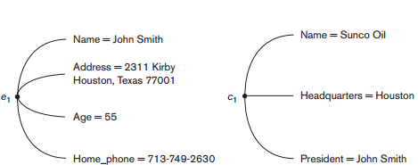
entities

Slide 3
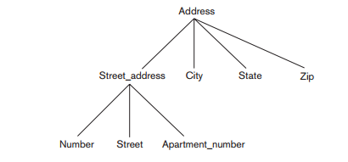
Composite attribute

Slide 4
Entity Types and Entity Sets.
An entity type defines a collection (or set) of entities that have the same attributes.
The collection of all entities of a particular entity type in the database at any point in time is called an entity set;

Slide 5
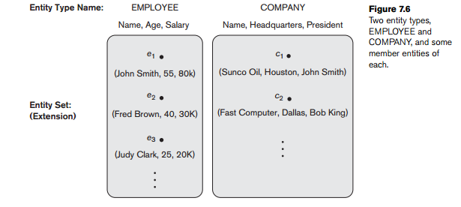
Entity Types and Entity Sets.

Slide 6
key attribute
An entity type usually has one or more attributes whose values are distinct for each individual entity in the entity set

Slide 7
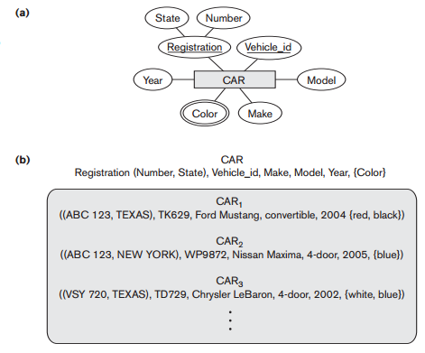

Slide 8
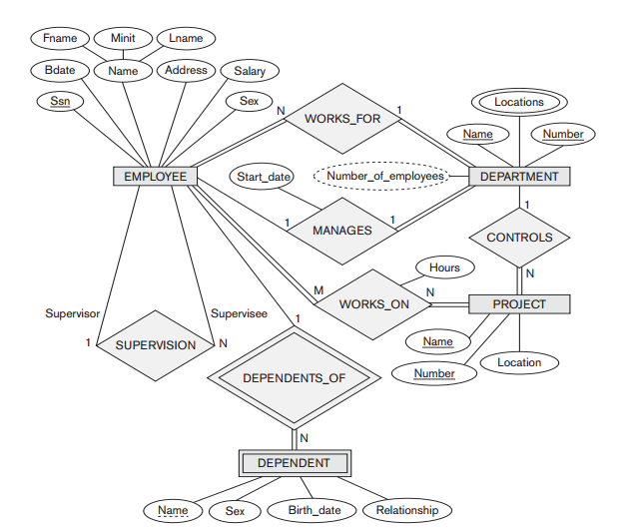
ER Diagrams

Slide 9
Relationship Types, Sets, and Instances
A relationship type R among n entity types E1, E2, ..., En defines a set of associations among entities from these entity types.
relationship set R is a set of relationship instances ri

Slide 10
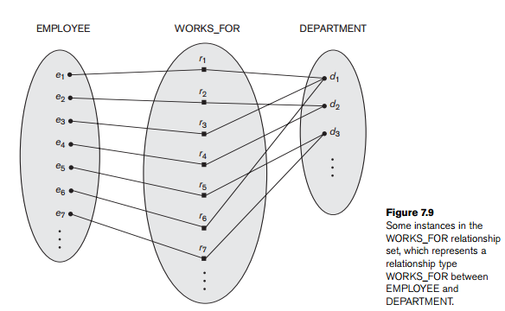
Relationship

Slide 11
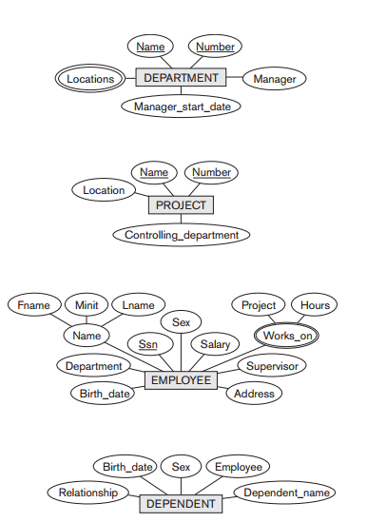

Slide 12
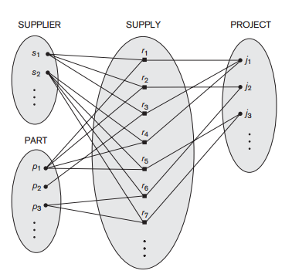

Slide 13
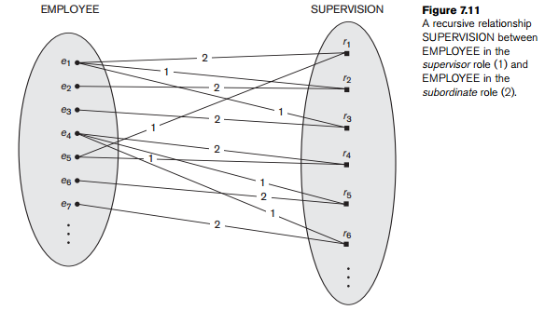

Slide 14
cardinality ratio-maximum number of relationship instances that an entity can participate in.
DEPARTMENT:EMPLOYEE-------1:N

Slide 15
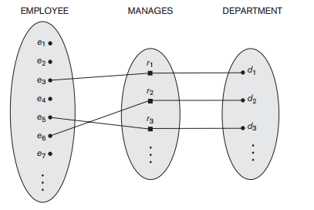
1:1

Slide 16
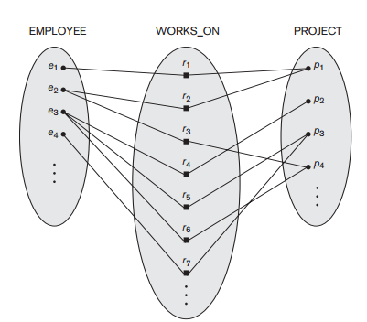
M:N

Slide 17
Participation Constraints and Existence Dependencies
minimum number of relationship instances that each entity can participate in, and is sometimes called the minimum cardinality constraint.
total (existence dependency )and partial
EMPLOYEE in WORKS_FOR-total
EMPLOYEE in the MANAGES
cardinality ratio and participation constraints, taken together, as the structural constraints

Slide 18
Weak entity types
Entity types that do not have key attributes of their own are called weak entity types
regular entity types/ strong entity types
identifying or owner entity type- identifying relationship
weak entity type always has a total participation constraint

Slide 19
ER Diagrams

Slide 20
partial key-, which is the attribute that can uniquely identify weak entities that are related to the same owner entity

Slide 21
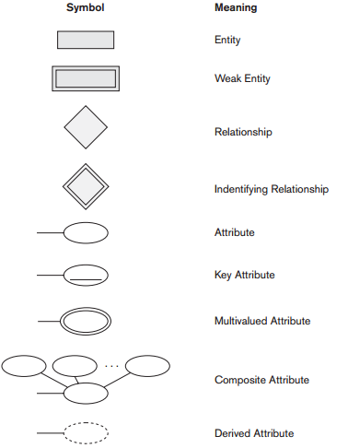

Slide 22
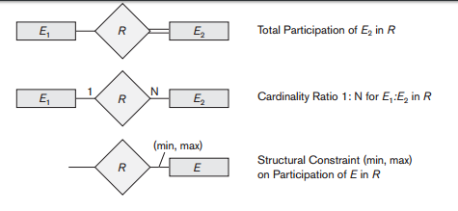

Slide 23
Relationship types of degree higher than 2
The existence of three relationship instances (s, p), (j, p), and (s, j) in CAN_SUPPLY, USES, and SUPPLIES, respectively, does not necessarily imply that an instance (s, j, p) exists in the ternary relationship SUPPLY, because the meaning is different

Slide 24
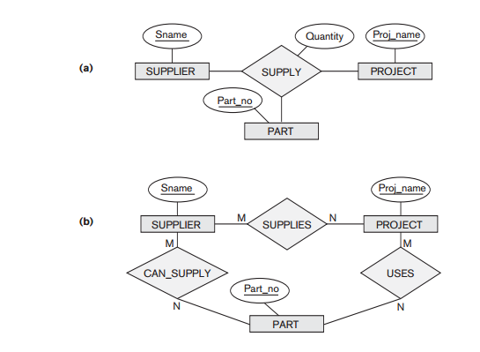

Slide 25
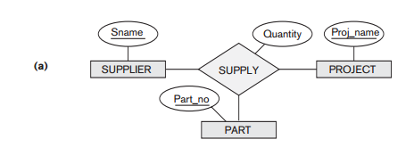
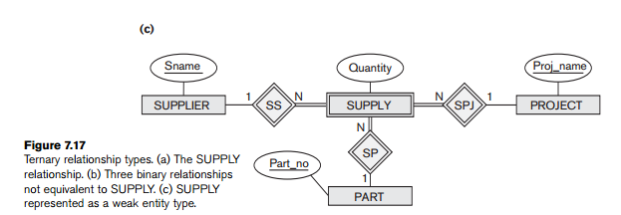
If no ternary relationship allowed then can represent as a weak entity type with no partial key

Slide 26
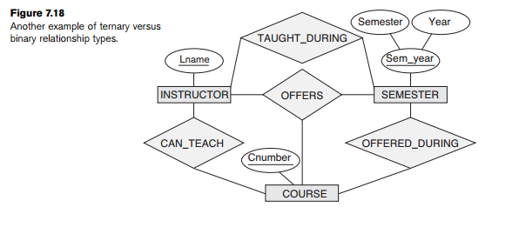

Slide 27
